Slide 1
CSCI3170 Introduction to Database Systems
Tutorial 7 Schema Refinement

Slide 2
Problems caused by redundancy
Waste of resources of storage
Potential inconsistency
Inability to represent certain information
Insertion Anomalies
Deletion Anomalies
Id | name | age | rating | Hourly_wages | Hours_worked
123-22-3666 | Peter | 48 | 8 | 10 | 40
231-31-5368 | Paul | 22 | 8 | 10 | 30
131-24-3650 | Mary | 35 | 5 | 7 | 30
434-26-3751 | Ada | 35 | 5 | 7 | 32
612-67-4134 | David | 35 | 8 | 10 | 40
Hourly_wages = f(rating)

Slide 3
Functional dependencies
Functional dependency (FD) is a type of constraint that is generalization of notation of key.
Definition
R - a relation schema, α ⊂ R, β ⊂ R (nonempty sets of attributes in R)
α → β if and only if,
For any relation r on R
For any two tuples t1, t2 of r
Пα(t1) = Пα(t2) ⇨ Пβ(t1) = Пβ(t2)

Slide 4
Example
 | A | B | C | D
1 | a₁ | b₁ | c₁ | d₁
2 | a₁ | b₂ | c₁ | d₂
3 | a₂ | b₂ | c₂ | d₂
4 | a₂ | b₂ | c₂ | d₃
5 | a₃ | b₃ | c₂ | d₄

Slide 5
Is A → C a Valid FD?
 | A | B | C | D
1 | a₁ | b₁ | c₁ | d₁
2 | a₁ | b₂ | c₁ | d₂
3 | a₂ | b₂ | c₂ | d₂
4 | a₂ | b₂ | c₂ | d₃
5 | a₃ | b₃ | c₂ | d₄
∴ A → C is a valid functional dependency!!

Slide 6
Is C → A a Valid FD?
 | A | B | C | D
1 | a₁ | b₁ | c₁ | d₁
2 | a₁ | b₂ | c₁ | d₂
3 | a₂ | b₂ | c₂ | d₂
4 | a₂ | b₂ | c₂ | d₃
5 | a₃ | b₃ | c₂ | d₄
∴ C → A is NOT a valid functional dependency!!

Slide 7
Is D → B a Valid FD?
 | A | B | C | D
1 | a₁ | b₁ | c₁ | d₁
2 | a₁ | b₂ | c₁ | d₂
3 | a₂ | b₂ | c₂ | d₂
4 | a₂ | b₂ | c₂ | d₃
5 | a₃ | b₃ | c₂ | d₄
∴ D → B is a valid functional dependency!!

Slide 8

Candidate Key
α is a superkey for R ⇔ α → R
α is a candidate key for R ⇔
α → R
There is no $γ$ s.t. $γ$ ⊂ α, $γ$ → R(minimal property)

Slide 9
Example
Given:
AC → R, AD → R, ACD → R
A | B | C | D
a₁ | b₂ | c₁ | d₂
a₂ | b₂ | c₁ | d₂
a₁ | b₄ | c₃ | d₃
a₄ | b₄ | c₃ | d₄

Slide 10
Example
Given:
AC → R, AD → R, ACD → R
A | B | C | D
a₁ | b₂ | c₁ | d₂
a₂ | b₂ | c₁ | d₂
a₁ | b₄ | c₃ | d₃
a₄ | b₄ | c₃ | d₄
∵AC → R
∴ AC is a super key
∵ A → R is not valid
C → R is not valid
∴ AC is a candidate key!

Slide 11
Example
Given:
AC → R, AD → R, ACD → R
A | B | C | D
a₁ | b₂ | c₁ | d₂
a₂ | b₂ | c₁ | d₂
a₁ | b₄ | c₃ | d₃
a₄ | b₄ | c₃ | d₄
∵AD → R
∴ AD is a super key
∵ A → R is not valid
D → R is not valid
∴ AD is a candidate key!

Slide 12
Example
Given:
AC → R, AD → R, ACD → R
A | B | C | D
a₁ | b₂ | c₁ | d₂
a₂ | b₂ | c₁ | d₂
a₁ | b₄ | c₃ | d₃
a₄ | b₄ | c₃ | d₄
∵ACD → R
∴ ACD is a super key
∵ AC → R is valid
AD → R is valid
(CD → R is not valid)
∴ ACD is NOT a candidate key!

Slide 13
Closure of F
F – { f₁, f₂, …, f_{i}, …, f_{n} }
Where f₁, f₂, …, f_{n} are functional dependencies
F implies f, if whenever all f₁, …, f_{n} are true, f is true
E.g. F = {A →B, B→C}, F implies A→C (by transitivity)
F⁺ – closure of F: the set of all functional dependencies that F implies
E.g. F = {A →B}
F⁺ = {A→A, B→B, AB→AB, A→B, A→AB, AB→A, AB→B}

Slide 14
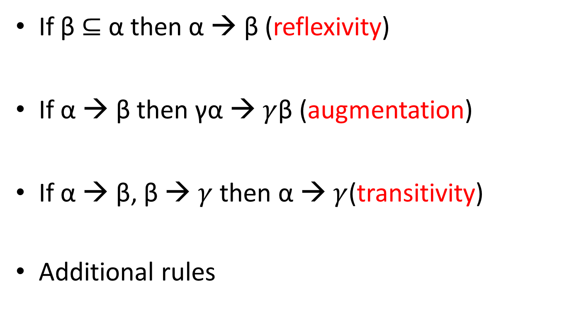
Armstrong’s axioms
If β ⊆ α then α → β (reflexivity)
If α → β then γα → $γ$β (augmentation)
If α → β, β → $γ$ then α → $γ$(transitivity)
Additional rules
{ A, C } ⊆ { A, B, C } ⇒ ABC → AC
A → B ⇒ CA → CB
A → BD, BD → C ⇒ A → C
Union: if X → Y and X → Z , then X → YZ.
Decomposition: if X → YZ, then X → Y and X → Z.

Slide 15
Example
R = (A, B)
F = {A →B}
F⁺ = {A→A, B→B, AB→AB, A→B, A→AB, AB→A, AB→B}
A→A, …(1)(reflexivity, {A} ⊆ {A})
B→B, …(2)(reflexivity, {B} ⊆ {B})
AB→AB, …(3)(reflexivity)
A→B, …(4)(given)
A→AB, …(5)(union of (1) and (4))
AB→A, …(6)(decomposition on (3))
AB→B, …(7) )(decomposition on (3))

Slide 16
Attribute Closure
Computing the closure of a set of FDs can be
expensive. (Size of closure is exponential)
Typically, we just want to check if a given FD
X → Y is in the closure of a set of FDs F. An efficient check:
Compute attribute closure of X (denoted X+)
Check if Y is in X+

Slide 17
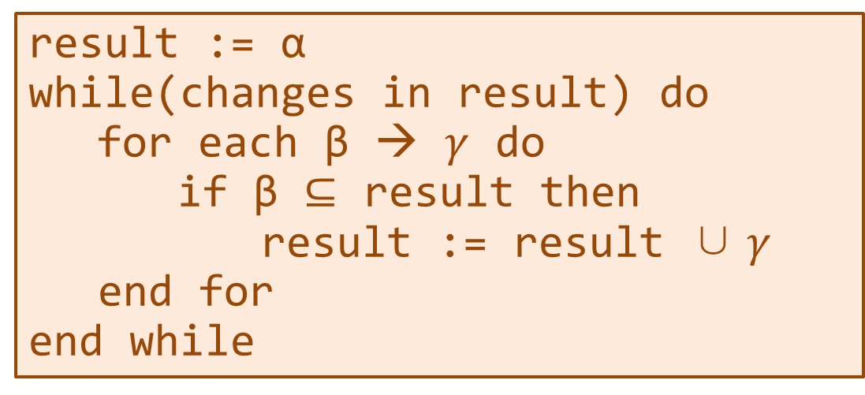
Attribute Closure
α – a set of attributes
α⁺ – closure of α under F (attribute closure)
Algorithm to compute α⁺:
result := α
while(changes in result) do
for each β → $γ$ do
if β ⊆ result then
result := result ∪ $γ$
end for
end while

Slide 18
Example
R = (A, B, C, D)
F = { A → B, B → C }
To compute A⁺ :
closure = A
closure = AB (A → B)
closure = ABC (B → C)

Slide 19
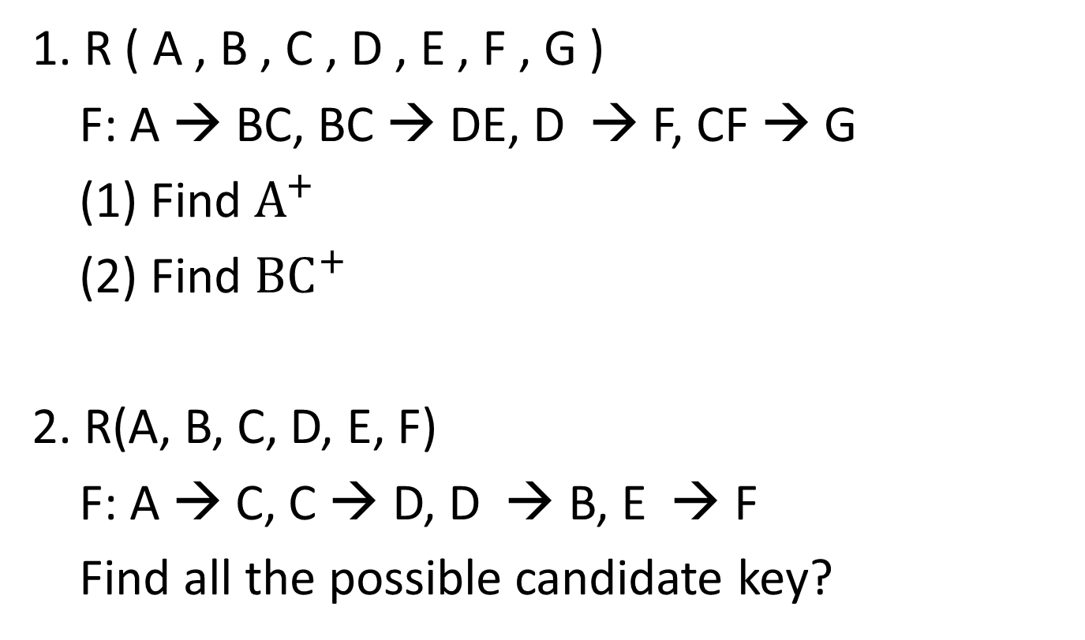
Class Work
1. R ( A , B , C , D , E , F , G )
F: A → BC, BC → DE, D → F, CF → G
(1) Find $A^{+}$
(2) Find ${BC}^{+}$
2. R(A, B, C, D, E, F)
F: A → C, C → D, D → B, E → F
Find all the possible candidate key?

Slide 20
Summary of keys
Super Key:
If the closure result of an attribute set contains all the attributes of the relation, then that attribute set is called as a super key of that relation.
Thus the closure of a super key is the entire relation schema.
Candidate Key:
If there exists no subset of an attribute set whose closure contains all the attributes of the relation, then that attribute set is called as a candidate key of that relation.

